Slide 1
New Hartford Historical Society
Website: https://newhartfordcthistory.org
Phone: 860-379-6894
Address: P.O. Box 41
529 Main Street
New Hartford, CT 06057

Slide 2
New Hartford, CT
Founding & Early Settlement
1733
New Hartford Historical Society
David C. Krimmel
September 2022

Slide 3
Our Presenter: David Krimmel
Town Historian Emeritus
25 Years with NHHS
Other Major Presentations: Brick Houses, Watson Houses
Thank you David!

Slide 4
Sources and Research
What went into researching this project:
100's of research hours!
Sources:
Town Clerk Documents
Multiple Books at NHHS
Distribution of Land 1733-1745 by David Krimmel (hardcopy available at NHHS)
Thank you to the people who helped: Town Historian Newman Hall got us off the ground researching.

Slide 5
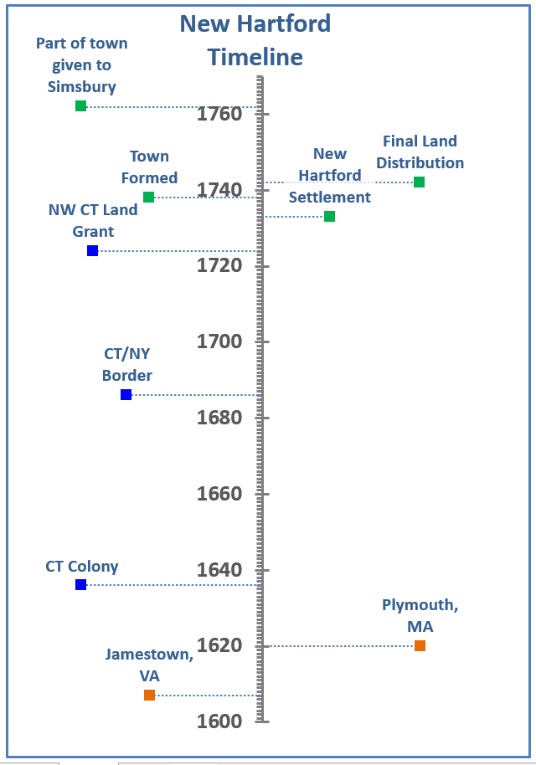
Timeline: Before 1733
Putting it into Perspective
1607- Jamestown, VA settled
1620- Plymouth, MA settled
1636- Connecticut Colony begins with Windsor, Hartford, and Wethersfield
1686- Connecticut vs. New York Boundary Colonial Assembly gives unsettled western lands to taxpayers of Windsor and Hartford

Slide 6
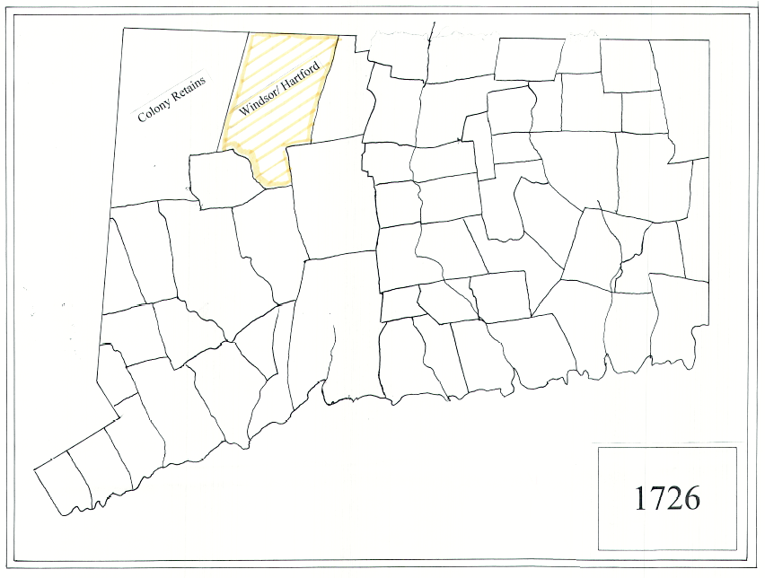
1726 Map

Slide 7
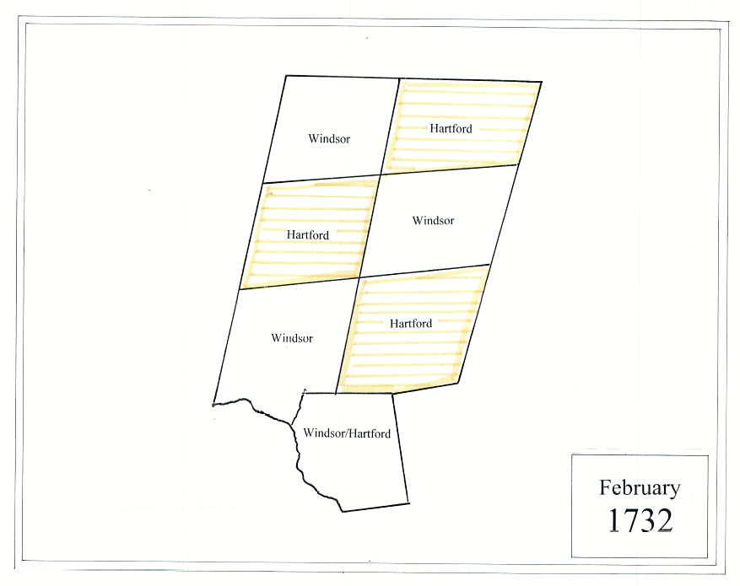
February 1732
Proprietors of Windsor and Hartford meet and decide to divide the land into 7 parcels of equal size.

Slide 8
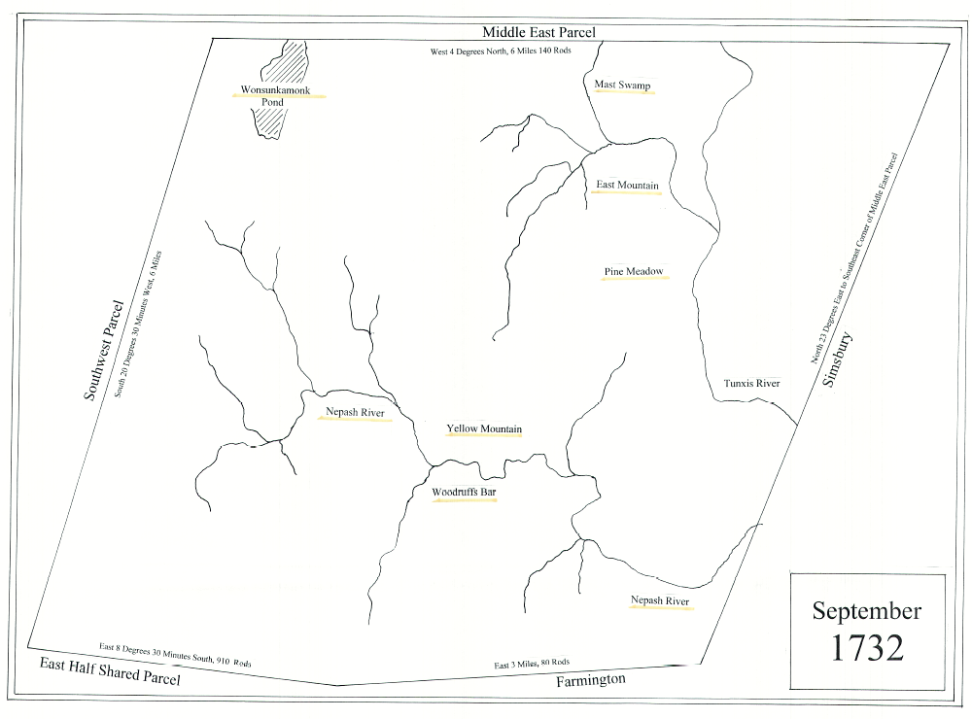
September 1732
181 of the 401 taxpayers of Hartford choose the southeast parcel.
The remaining 220 choose one of the other Hartford parcels.

Slide 9
1733
January: 181 Proprietors of the Southeast Parcel meet. They appoint a committee to view the and advise how to distribute it.
April:
  The committee recommends that sufficient land be immediately distributed to each proprietor to allow them to establish a home site.
  They allot 1/4 acre for each pound of the proprietor’s estate on the 1720 tax list.
  Names were drawn and the Surveyors calculated the size of each lot and laid them out in the sequence in which they were drawn. These were called Home Lots.
May: The Colonial Government named the Southeast Parcel New Hartford.
September:
  The Proprietors meet to discuss further distributions of land.
  They laid 8 highways running south to north which would become the east west boundaries within which each proprietor could choose the location of his land in further distributions.
December: The Proprietors drew names for the second and third distributions of land which would entitle each proprietor ½ acre for each pound on the 1720 Tax List.

Slide 10
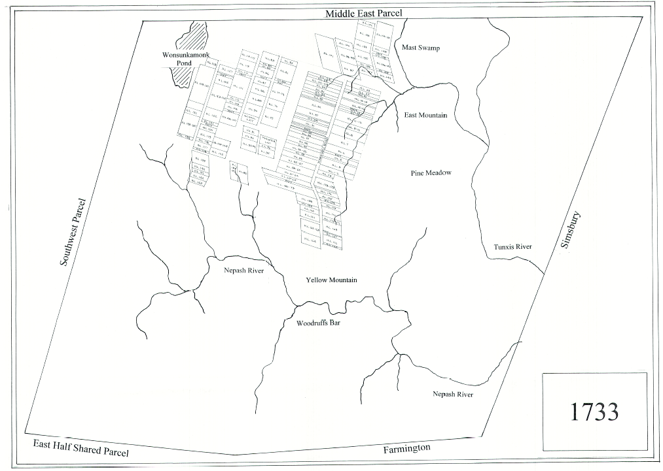
1733 Map

Slide 11
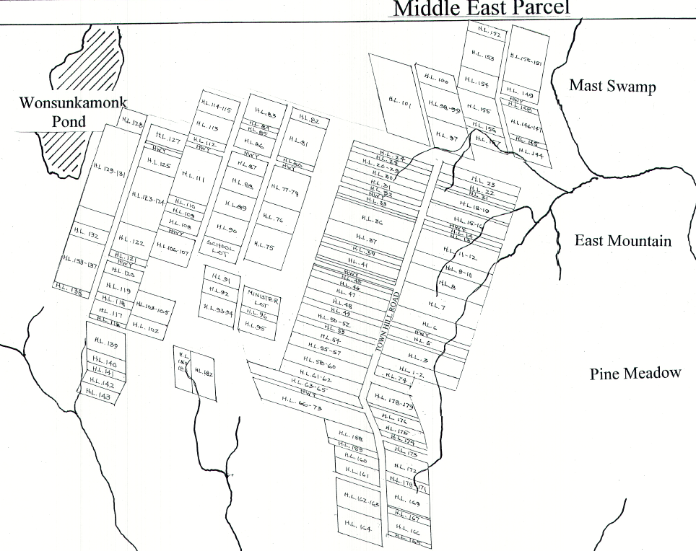
1733 Map
Detail

Slide 12
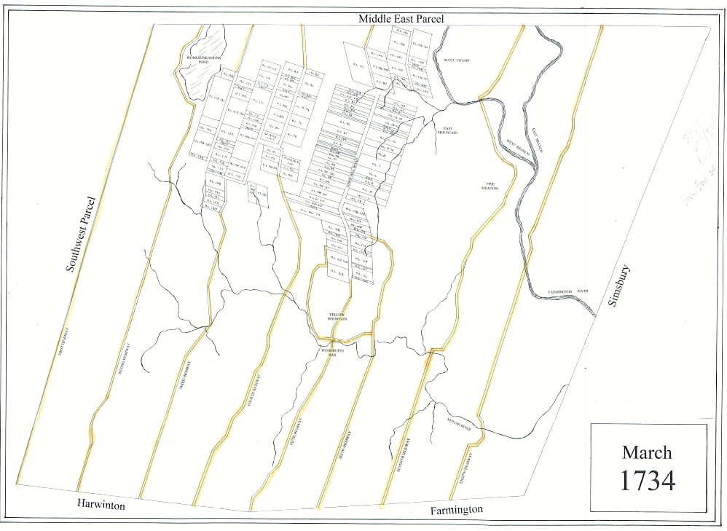
1734
They laid 8 highways running south to north which would become the east west boundaries within which each proprietor could choose the location of his land in further distributions.
The Proprietors began choosing the location of their lot in the 2nd Division and the Surveyors began laying out the parcels.

Slide 13
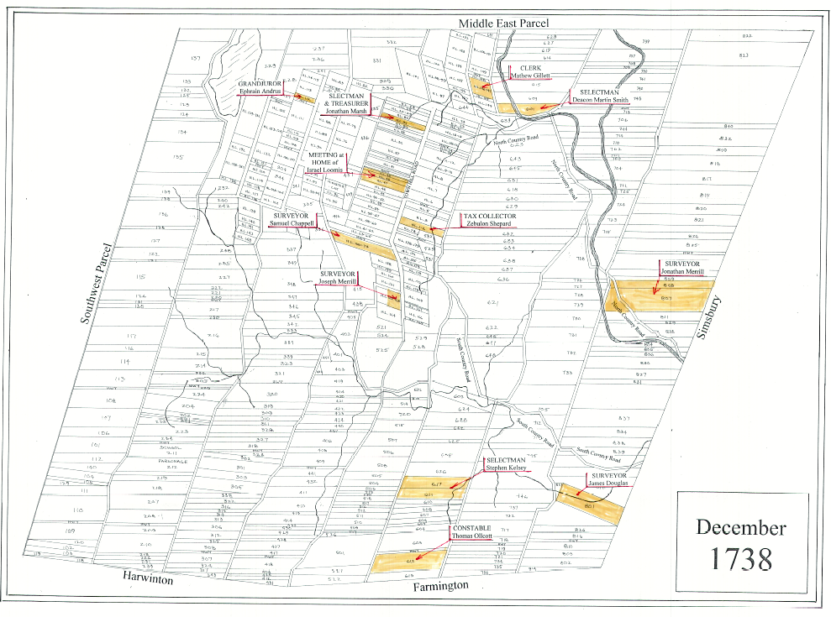
1734-1738: Further Distributions
1734: The Proprietors began choosing the location of their lot in the 2nd Division.
Surveyors began laying out the parcels.
Proprietors continued with this process until all choices were finished for the 2nd and 3rd Division.
1735: Proprietors drew the 4th land distribution. Each proprietor would receive ¾ acre for each pound on the 1720 Tax List.

Slide 14
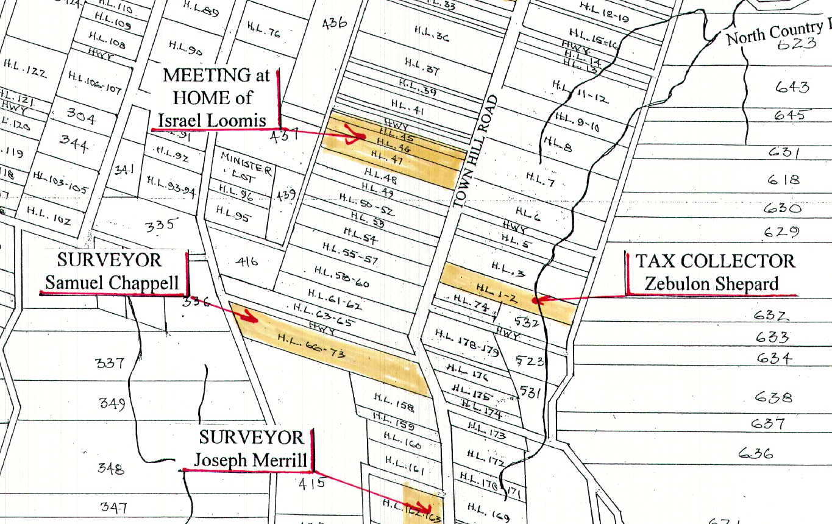
1738: Town Founding
The Proprietors petition the Colonial Government for permission to form a Town. Permission is granted, in October.
The first Town Meeting was held on December 19, 1738.

Slide 15
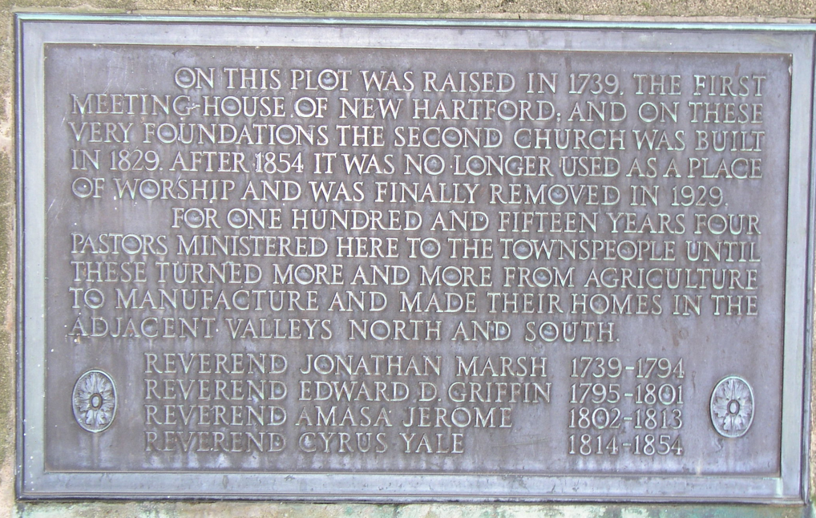
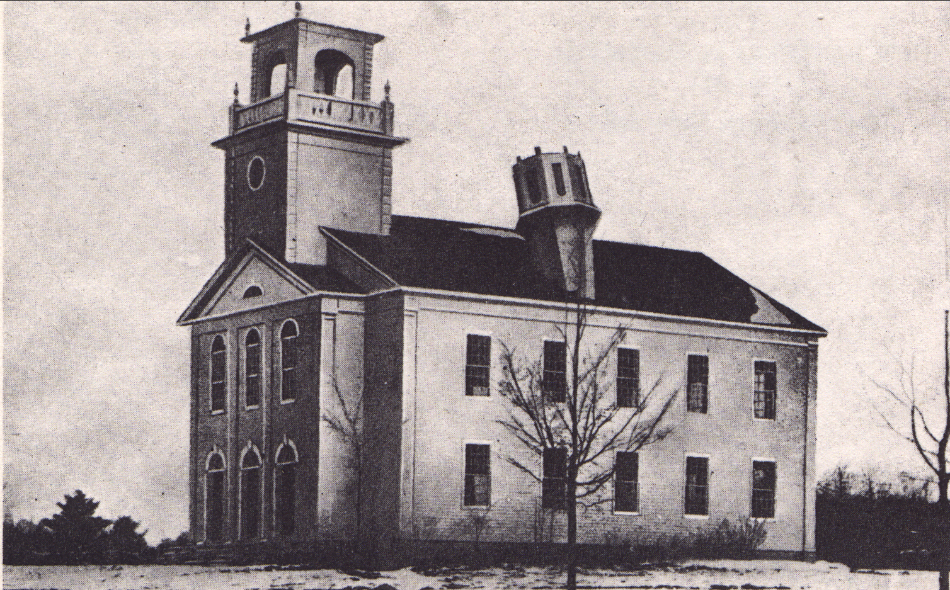
1739-1742: Town Progressing
1739: Land for a Meeting House and Burial Ground was purchased on Town Hill and Reverend Jonathan Marsh was installed as the minister of the Church.
1742: The Proprietors drew lots for the fifth and final distribution of land. Surveyors continued to lay out lots.
1829 Church Built
1929 Church Removed

Slide 16
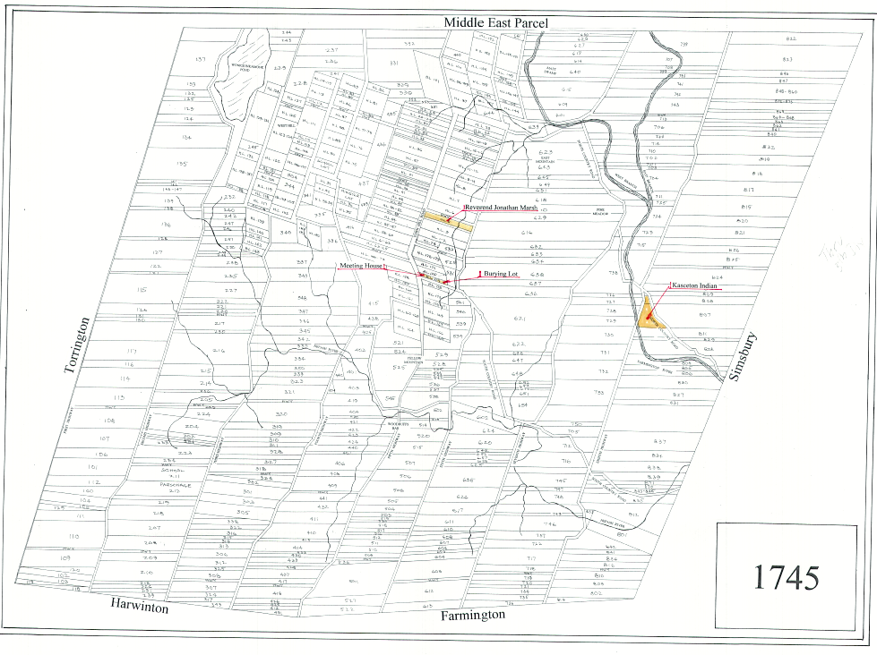
1745
Population continues to grow
First burial in Town Hill Cemetery: Stephen Kelcy Selectman
Town Meeting House under construction
Reverend Jonathan Marsh is in residence
The surveyors continue laying out lots
First deed recorded showing transfer of land to a native American Indian called Kasceton.

Slide 17
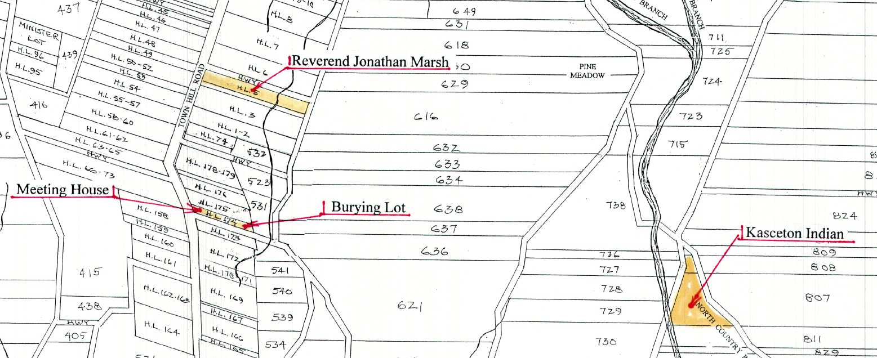
1745 Detail

Slide 18
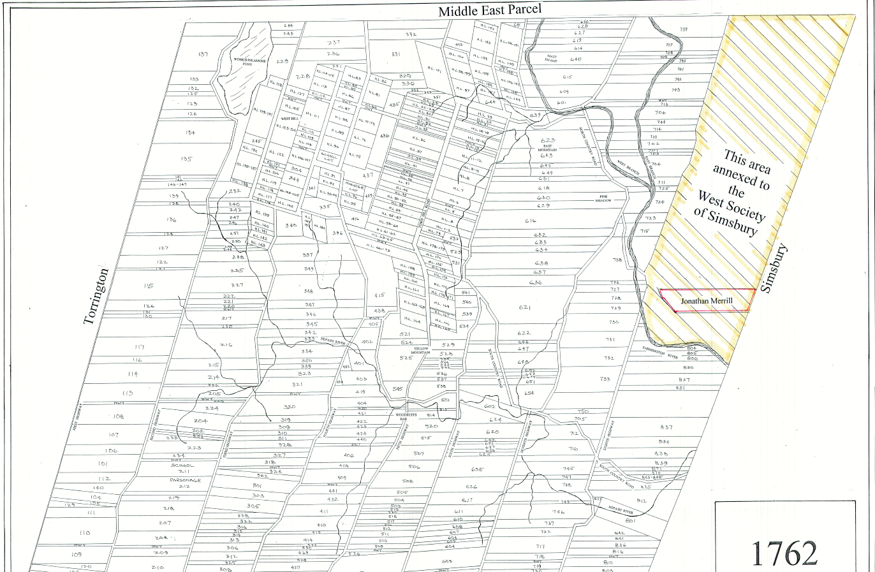
1749-1762
1749
  The Meeting House is completed. All Lots are laid out. The Proprietor’s work is complete.
  The Proprietors transfer all undistributed land and highways to the Town of New Hartford.
1762
  Residents in the northeast tier of lots petition the Colonial Government to be annexed to the adjoining Town of Simsbury. Permission was granted and the boundaries of New Hartford were changed.

Slide 19
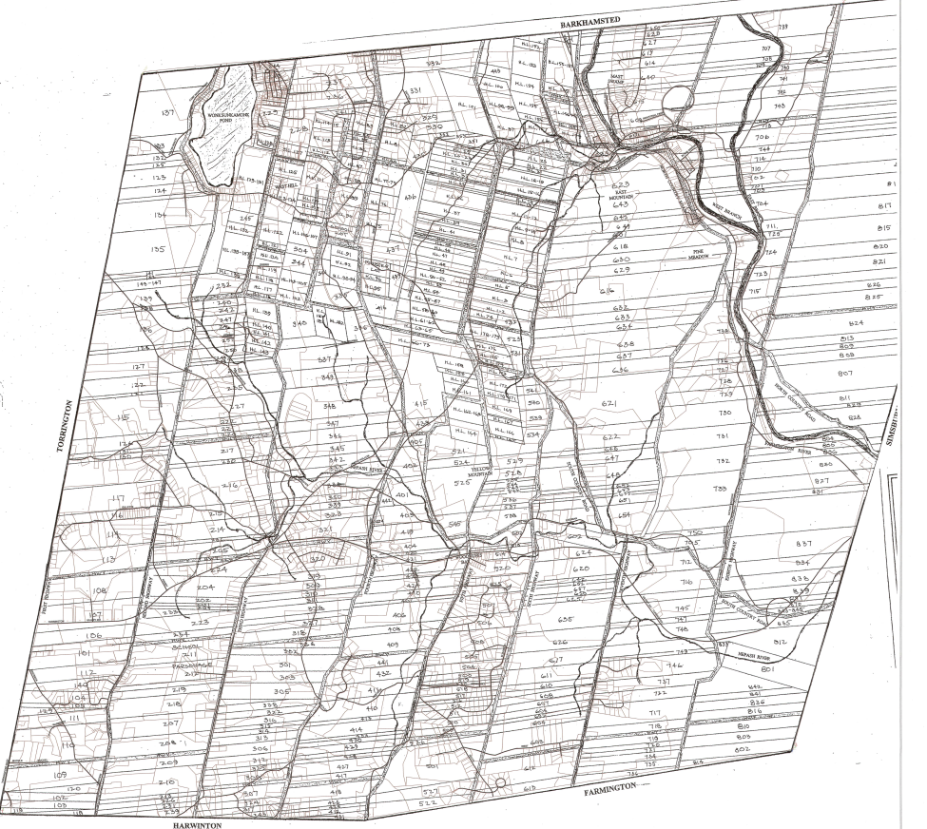
Overlay of current NH vs. 1745 Map

Slide 20
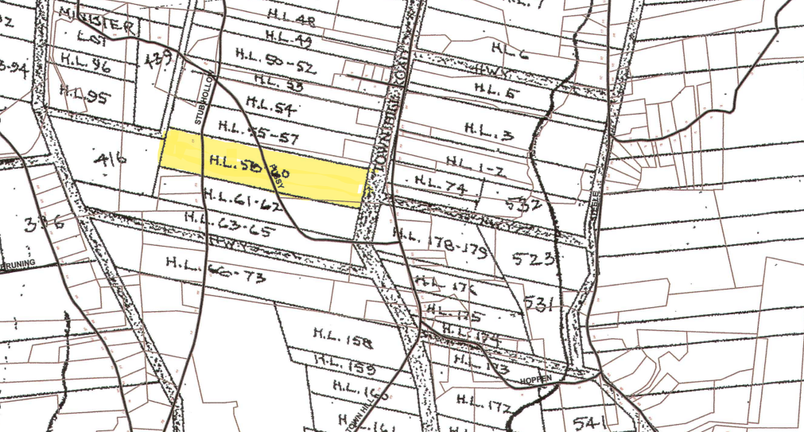
Overlay Detail

Slide 21
New Hartford Founding and Settlement
1724: The Colonial Government gives unsettled land in Northwestern Connecticut to Hartford property owners on the 1720 Tax List.
1732: The boundaries of the parcel are surveyed and a deed to the land is given to 181 Hartford Taxpayers called Proprietors.
1733: The Founding:
  Names are drawn from the list of 181
  Surveyors calculate the size of each owner’s lot and lay them out in the sequence in which they were drawn along Town Hill and westerly toward Wonksunkamonk Pond. These were called Home Lots.
  The Colonial Government names the parcel New Hartford. People begin to settle.
  The Proprietors draw lots for the second and third distribution of land.
  Eight highways are laid out, running south to north connecting the Home Lots. They provide east-west boundaries within which Proprietors chose the location of land to which they are entitled in subsequent distributions of land.
1734: Surveyors begin laying out lots as Proprietors choose. Settlers begin moving to these new locations.

Slide 22
New Hartford Founding and Settlement (cont.)
1735: The Proprietors draw lots for the fourth distribution of land. Surveyors continue laying out lots from the second and third distribution along with lots chosen in the fourth distribution.
1738: The Proprietors petition the Colonial Government for permission to form a Town. Permission granted and the first Town Meeting was held with election of officers on December 19, 1738.
1739: Land for a meeting house was purchased on Town Hill and Reverend Jonathan Marsh was installed as minister of the Church.
1742: The Proprietors draw lots for the fifth and final distribution of land. Surveyors continue laying out lots as they are chosen.
1749: The meeting house is finished. All lots are laid out. Proprietors work is complete.
1762: Residents in the northeast tier of lots petition the Colonial Government to be annexed to the adjoining Town of Simsbury. Permission was granted and the boundaries of New Hartford were changed.

Slide 23
Lot size per distribution
1733: Home Lots: ¼ acre per pound on 1720 Grand List.
1734: Second and third division of land at ½ acre per pound.
1735: Fourth division: ¾ acre per pound.
1742: Fifth and final distribution 1/8 acre per pound.
Example: Merril Properties totaled XX acres due to their prominence.

Slide 24
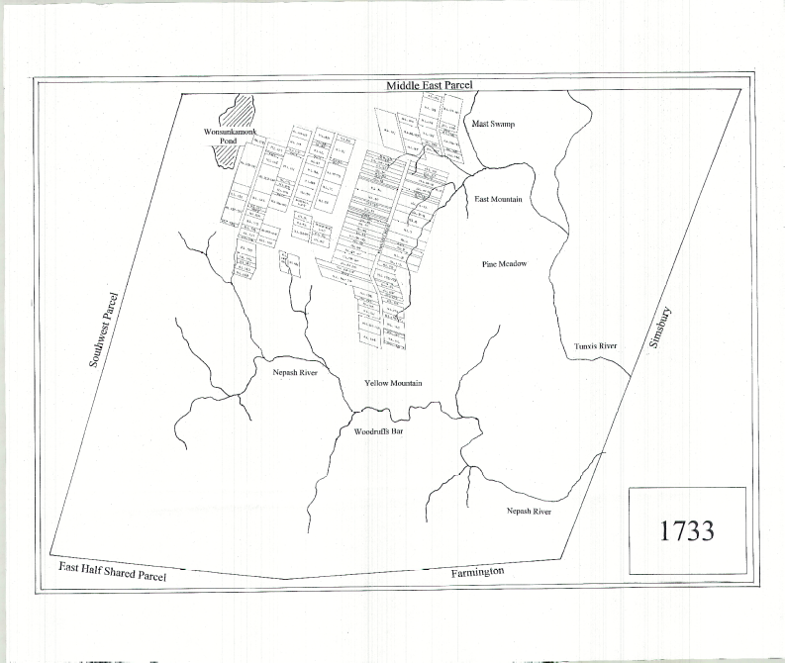
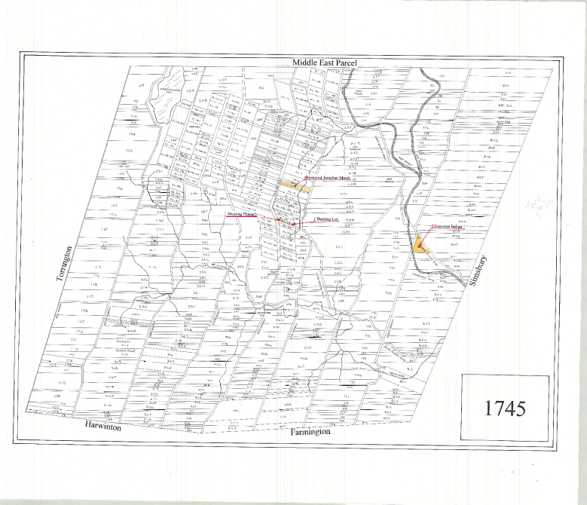
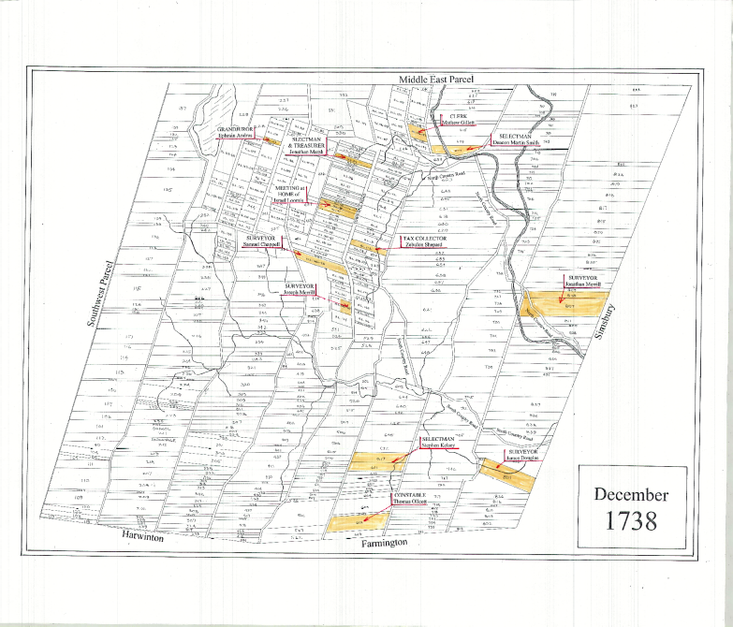
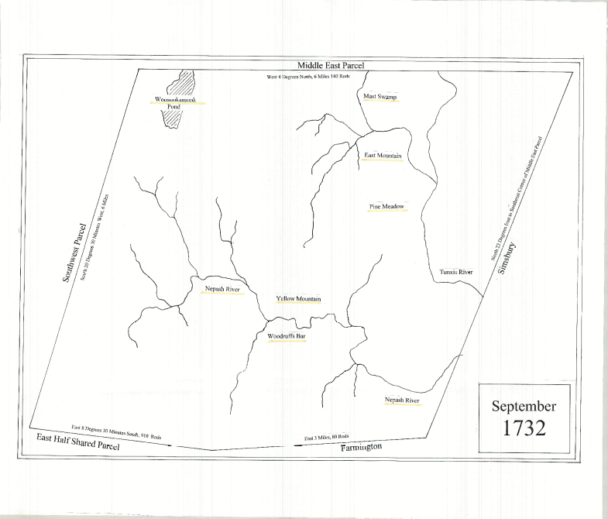
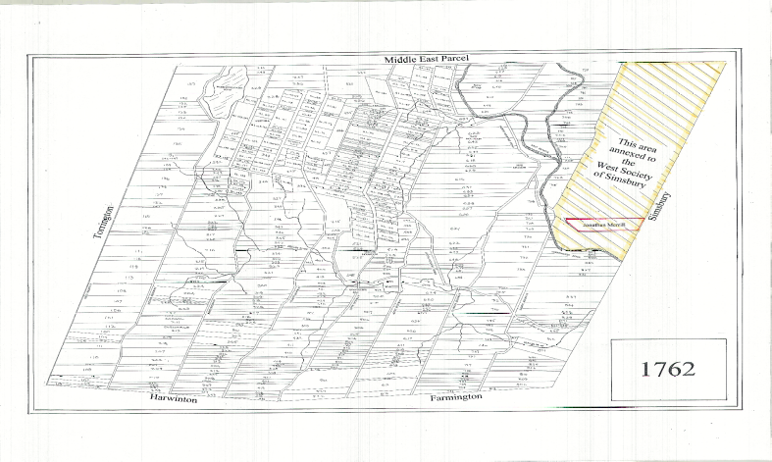
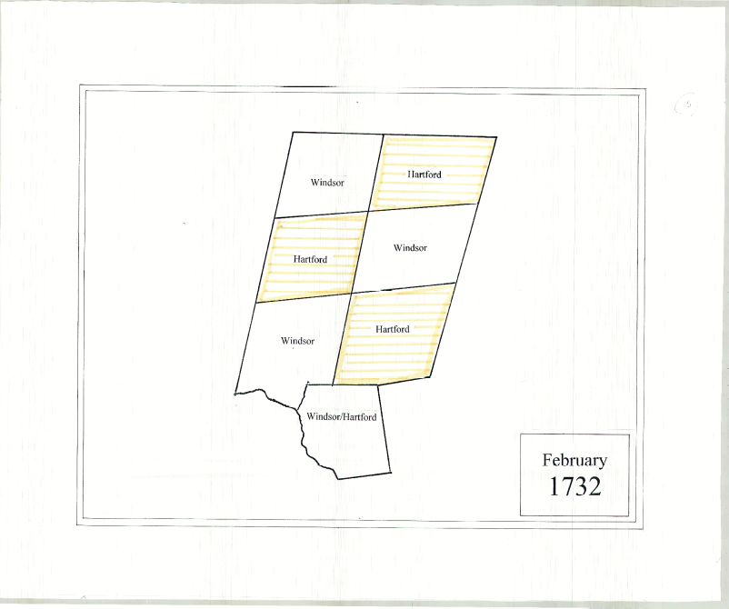
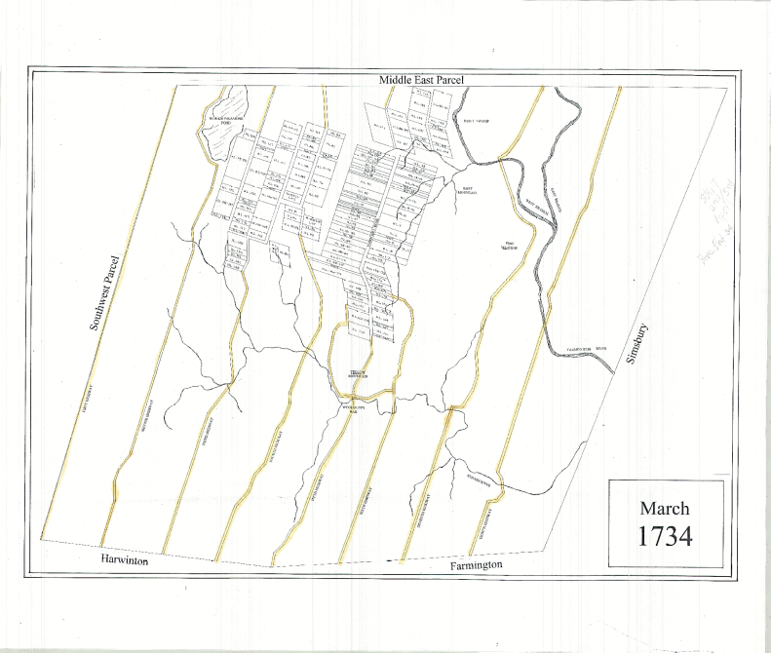
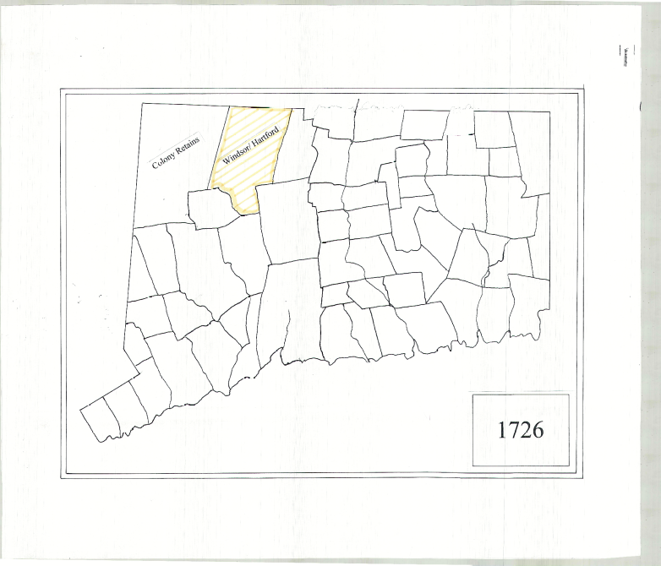
PDF Maps

